Slide 1

FIFA World Cup
statistics through the years
Rafia Tazeen
Manisha Reza Paul
Laura Faulds
Parshant Mahajan
Emad Moro

Slide 2

Problem Statement & Motivation
we decided to go for a sports theme because we wanted a playful & light-hearted topic that could keep our audience (and ourselves!) engaged
we chose the fifa world cup rather than a national league because it is a globally unifying event with many facets to explore
we decided to explore & visualize our dataset by year rather than by country to see how the event had evolved over time

Slide 3
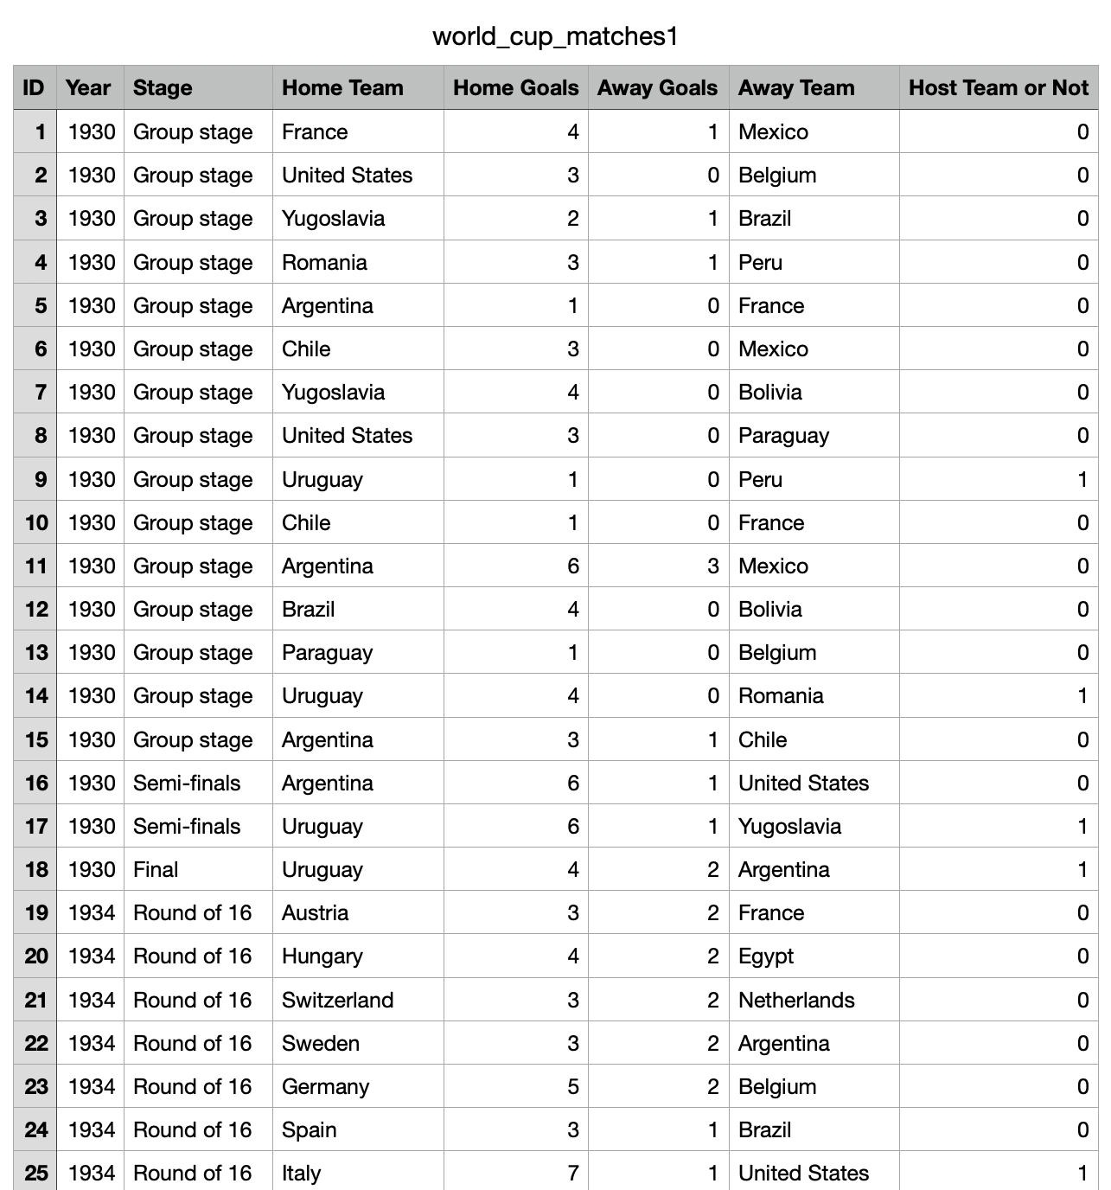
2. OUR DATA SOURCE
our original data set was found on kaggle & contained 4 csv files with various levels of utility
we chose to focus on the csv that operated at the highest level, with 8 columns & 900 rows
this dataset permitted us to explore the data using our desired year-by-year perspective
it also provided it us with the option of focusing on countries, goals, and stages, rather than just focusing on one area
the biggest challenge: we were missing half the data for 2022! :(

Slide 4
3. SOLUTION WORKFLOW DIAGRAM
CSV FILE
(found on kaggle)
MASTER
JSON FILE
(data.json)
PANDAS DATAFRAMES
UPDATED JSON FILES
FLASK APP
LOAD & READ USING
SQLITE
PLOTLY &
LEAFLET
LIBRARIES

Slide 5
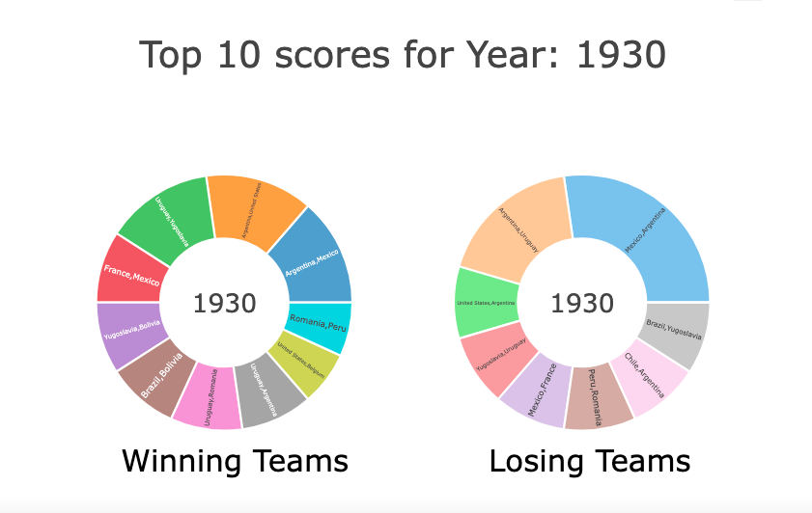
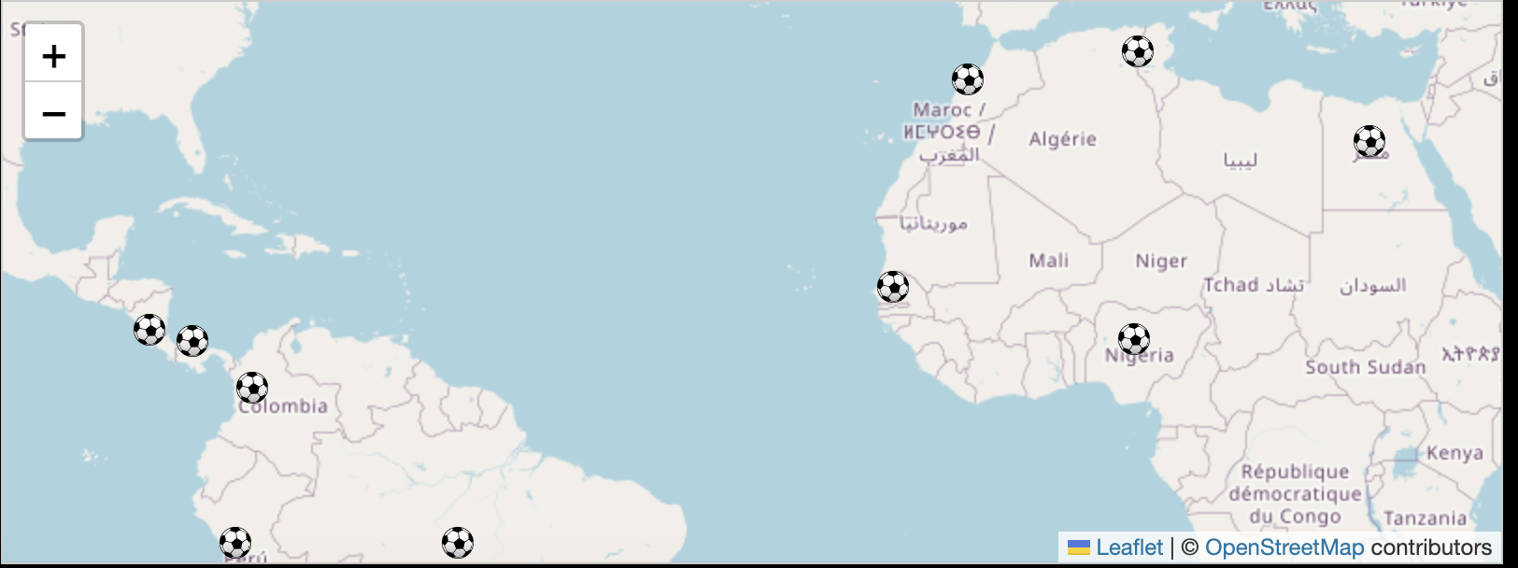
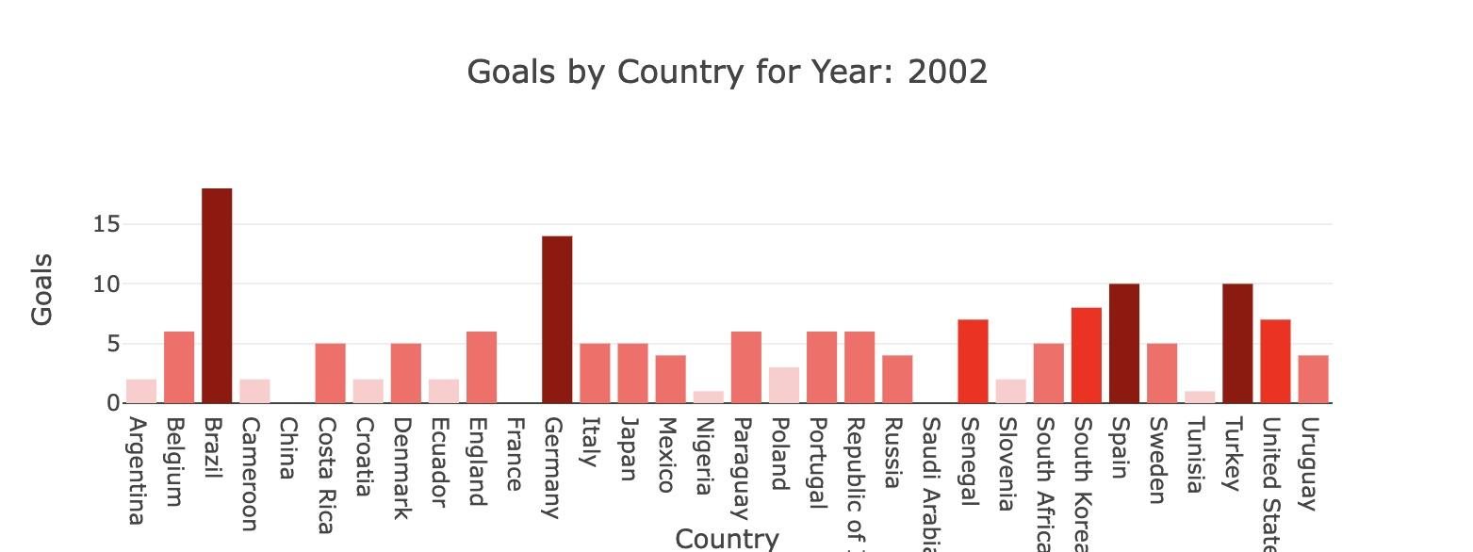

4. Visualizations
donut chart: winners vs. losers
map visualization: participating countries
logos through the years
(this one is just for fun)
bar chart: goals by country

Slide 6
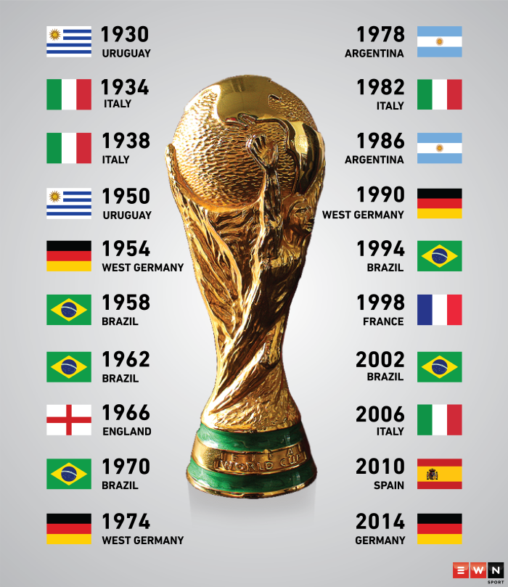
⚽ Winners through the years ⚽
also, shout out to france 🇫🇷 & argentina 🇦🇷,
the 2018 & 2022 winners!

Slide 7

5. Highlight insightS
as we go through the data year by year, we see the effects of globalization resulting in a larger & more diverse group of countries
despite first world countries having more resources to invest into their world cup performances, the top & bottom teams vary tremendously from year to year!
the team who scored the most goals over the course of the world cup is not always the winner!

Slide 8

6. Limitations & assumptions
original dataset only included goals scored per match rather than per tournament
dataset presented two columns as home teams vs. away teams, which we found difficult to interpret
some countries included in today’s dataset no longer exist in today’s era and therefore had to hard code some information into our map visualization

Slide 9

7. Unrealized dreams
(aka “what we would do
if we had the opportunity
to extend this project”)
as per our original plan, we would include a visual representation of each year’s winner and runner-up to streamline analysis
would love to explore larger font libraries and play around more with the CSS style elements of the site
we would incorporate an audio element & have each year’s world cup song play as the dropdown changed 🎶 🎶 🎶
above: us when we couldn’t get our code to work

Slide 10

TIME FOR OUR DASHBOARD DEMO!
Time for our dashboard demo!

Slide 11

thank you!!!

